Slide 1
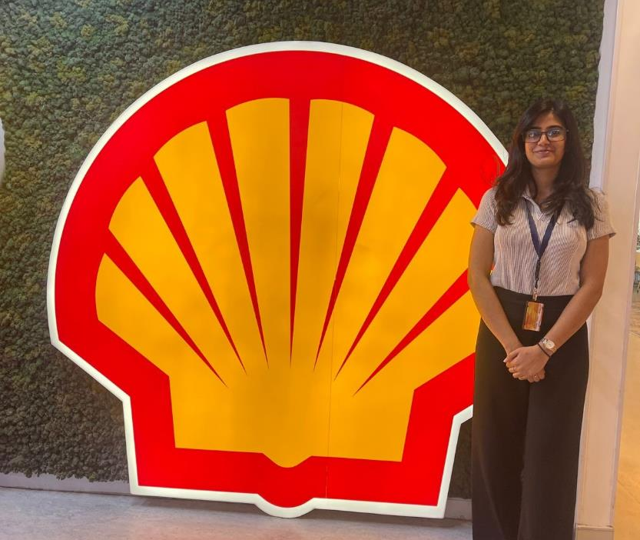
Shell Bootcamp 2024 3 Reflections for Week 1
Anisha Sharma
Date : 30-Aug-2024

Slide 2
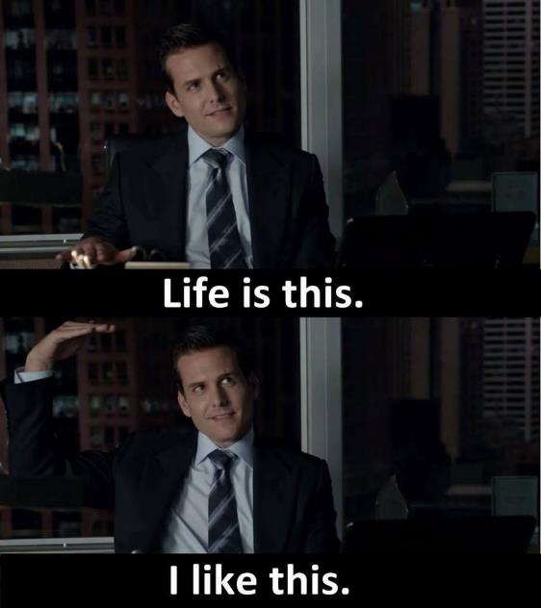
About Me
‘According to me’ is the only ‘according to’ that matters

Slide 3

My learnings from this week!

Slide 4

Learning 1 | My takeaways
We had a soft skills session on Professionalism, Grooming and Etiquettes.
Key learning: Recognized the impact of effective communication skills, commitment and ownership.
Key takeaway: Always strive to maintain a professional attitude.
Well-written emails are crucial for clear communication and can help avoid misunderstandings.
Comprehend the significance of personal appearance in creating a positive first impression.

Slide 5
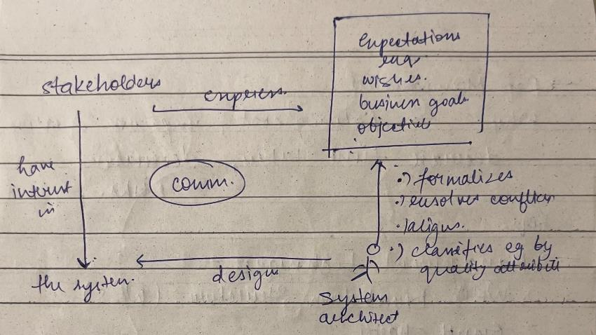
Learning 2 | My takeaways
Stakeholder Management and Teamwork
Key learning: Identifying the types of stakeholders by using Power Interest Grid Techniques. And that there is no I in a team and that we should always look out for other teams as well.
Key takeaway: Stakeholders plays a really important role in our personal as well as professional life and being a team player, includes synchronizing, dedication, engagement, determination and focus.
Energy sector stakeholders requires a strong commitment to sustainability and the expectations from the products.

Slide 6
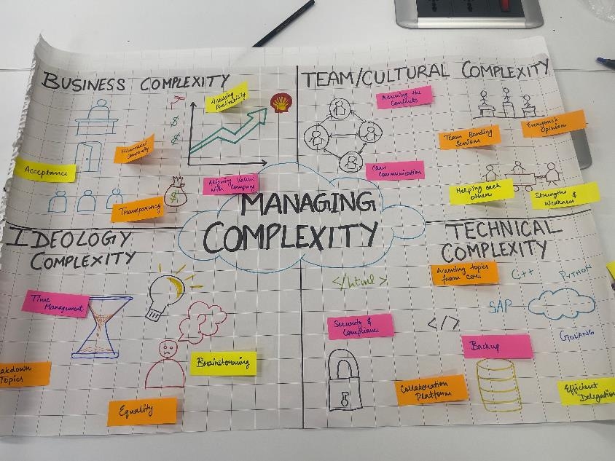
Learning 3 | My takeaways
Importance of Business Analysis and Management.
Key learning: With the help of BA any business can run smoothly.
Key takeaway: BA is the discipline of identifying business needs and analysis and it needs a comprehensive understanding of both business and technical aspects. And that you should learn before starting your own organization/company.
I personally see this concept implemented in the Energy sector in monitoring energy market trends and regulatory changes and to assess the impact of renewable energy projects.

Slide 7

Relevance of learnings for my organization

Slide 8

Learning 1 | Relevance for Shell
Shell contributes to the professionalism and grooming very seriously. They make their employees work on personal knowledge & skills so that they can contribute towards quality work with a positive attitude.
Shell made me understand my mindset and helped me showcase my professional qualities.

Slide 9

Learning 2 | Relevance for Shell
Shell is very inclusive regarding its stakeholders whether it may be internal or external. They provide regular updates and a transparent communication about their strategies and results.
Shell gave me a platform to collaborate and interact with creative, innovative, motivated and like-minded people which would help me upskill me in my career at shell.

Slide 10

Learning 3 | Relevance for Shell
Shell uses Agile methods for their SDLC and in which they mostly uses Scrum. They also focuses on customer collaboration and using the agile workflow process based on a repetitive approach.
Shell benefits from this technique by time estimation and logging work to store and manage information about the time spent in a project.

Slide 11

Challenges in implementing learning

Slide 12
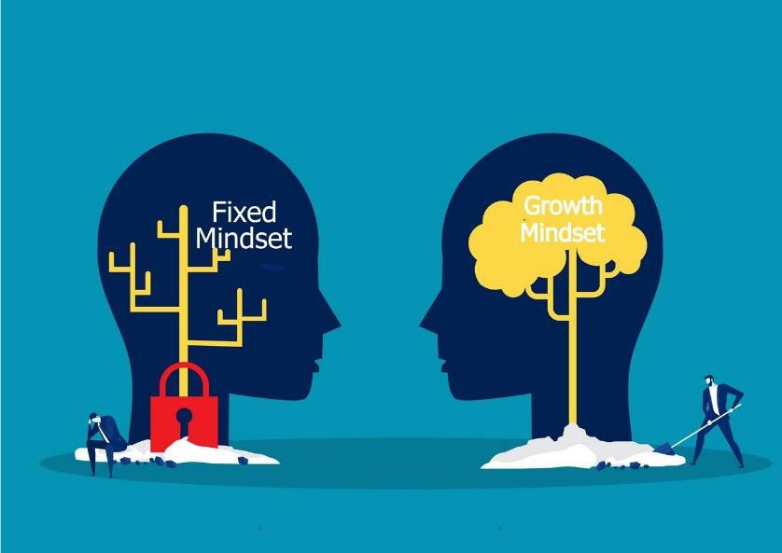
Challenge faced while implementing Learning 1
Having a growth mindset and changing the thinking of the fixed mindset must be the most challenging part. Fixed mindset would let me stay in my bubble of comfort and wouldn’t let me grow as an individual

Slide 13
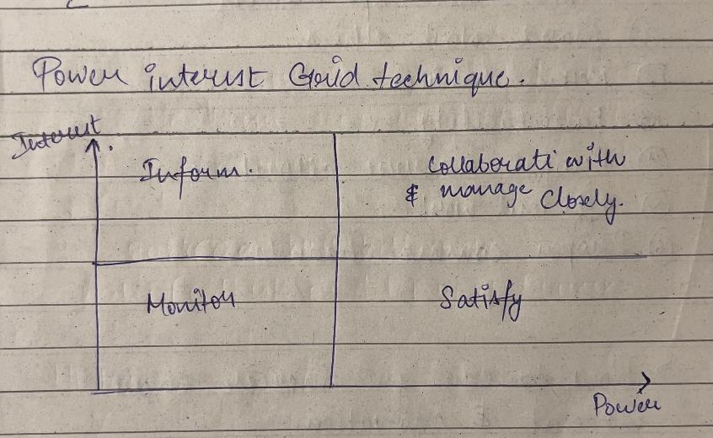
Challenge faced while implementing Learning 2
Understanding the importance of different stakeholders in an organization. Usually, the people with whom we collaborate with and manage stuff closely are the once we consider as the main stakeholders, but there are plenty important ones too which comes under satisfy, inform and monitor part.

Slide 14
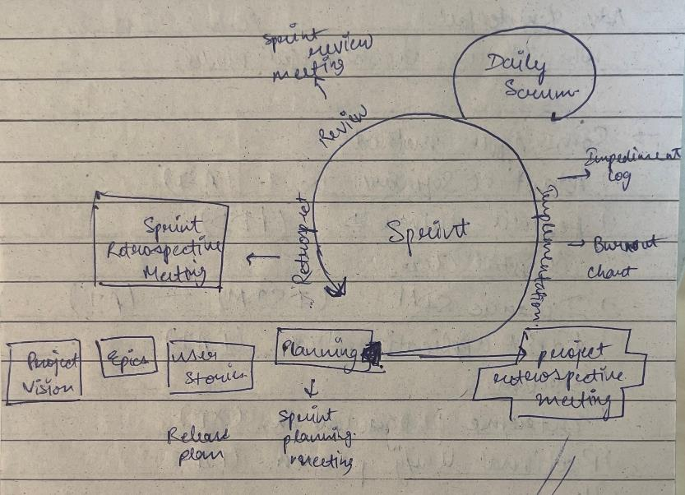
Challenge faced while implementing Learning 3
The challenge faced while implementing this learning would be to understand the story point estimations and to manage the burndown chart.

Slide 15

Action Plan

Slide 16
My Action Plan for this Week
Actions
Timeline
Status
Interacting with my peers from other batches.
Setting up GTKYs with the members of my line of business to know more about Shell and my work.
Day 1-3:
Roleplay
JAM Sessions
Teamwork
Day 4-5:
Business Analysis
Agile Framework
Met a few people from different batches as well as from my line of business.
Actively participated in training sessions and roleplays.

Slide 17

Learning is also Fun!

Slide 18
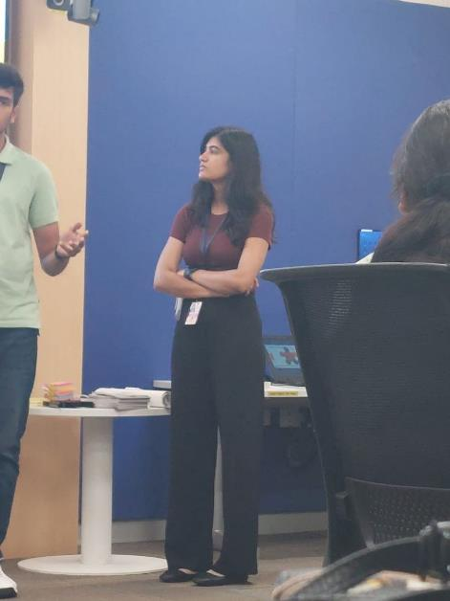
Learning is also Fun!
Our facilitators for Soft skills and Foundational Training conducted the sessions in a very fun manner.
For soft skills we were continuously being changed into different teams so that we get comfortable with our batchmates and were asked to do some roleplay activities.
In the foundational training she taught us about the agile model framework by making us do a roleplay and make project for real life examples like either selling a product or creating User Stories for energy sector projects.
Here I was presenting our group poster on Managing Complexity

Slide 19

Summary
Quick summary
This week in the first 3 days we had our Soft Skills training where we had a roleplay on Meeting etiquettes, we were asked to create a poster on Managing Complexities for stakeholder management, and some other fun and interactive activities.
For the next 2 days we had our Foundational Training where we were taught about the importance of Business Analysis in a company and about different Management Techniques. We even had some roleplays and JAM sessions for the same.
Importance of topics of upcoming week
The upcoming topics are going to be very technical like Azure DevOps, Software Testing, DBMS, and a group case study to solve.
Connectivity of topics from current week
This week’s topics like professionalism and business analysis are always going to help me in my professional career.

Slide 20
Thank You

